Slide 1
Blogging Along
Encouraging Engagement,
Reflection and Connection
In 3D Design and Sculpture

Slide 2
Blogs: Structured Learning/ Engagement Replication of the structure of the on-ground studio classroom Combo of Class Participaton and
On ground class structure:
Daily goals/objectives/tasks for each studio session:
Research, brainstorming, testing materials, experimentation, learning new skills, continued work, revisions

Slide 3
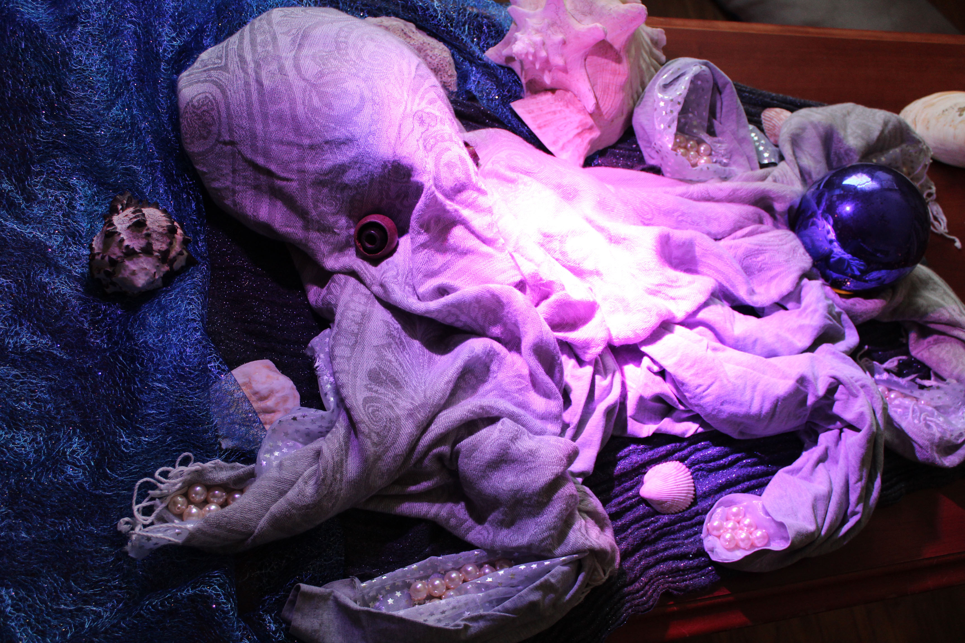
Why Blogs? Engagement A way to replicate the dynamic exchange of the on-ground studio classroom
On ground class structure:
“Walk Arounds”:
Engagement based on sharing discoveries, challenges, ideas for next steps, questions, pushing beyond the assignment

Slide 4
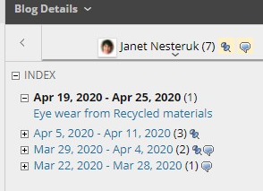
Blog Tool Basics
Accessible through Tools menu
Each student can have their own blog, public to the class
Students can post images, text, videos, mashups, etc.
Students can comment and respond to each other publically
Entries organized chronologically ; catalogued in Blackboard
“You got mail!” – push pin signals new entries
Entries can be graded or ungraded
(Blog entries part of my class participation and Journal grades)

Slide 5
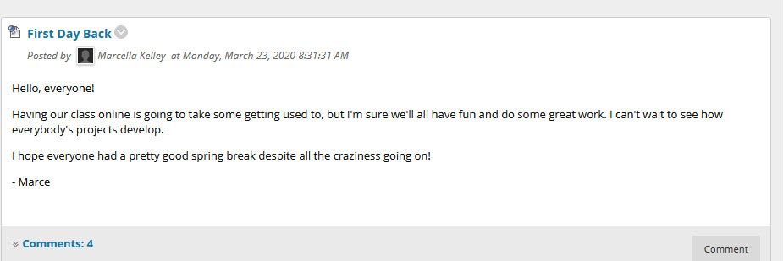
Blogs: Connection Colloquial, personal tone to dialog (with Netiquette!)
Clarke, L, & Kinne, L. (2012). Asynchronous discussions as threaded discussions or blogs. Journal of Digital Learning in Teacher Education, 29, 4-13.

Slide 6
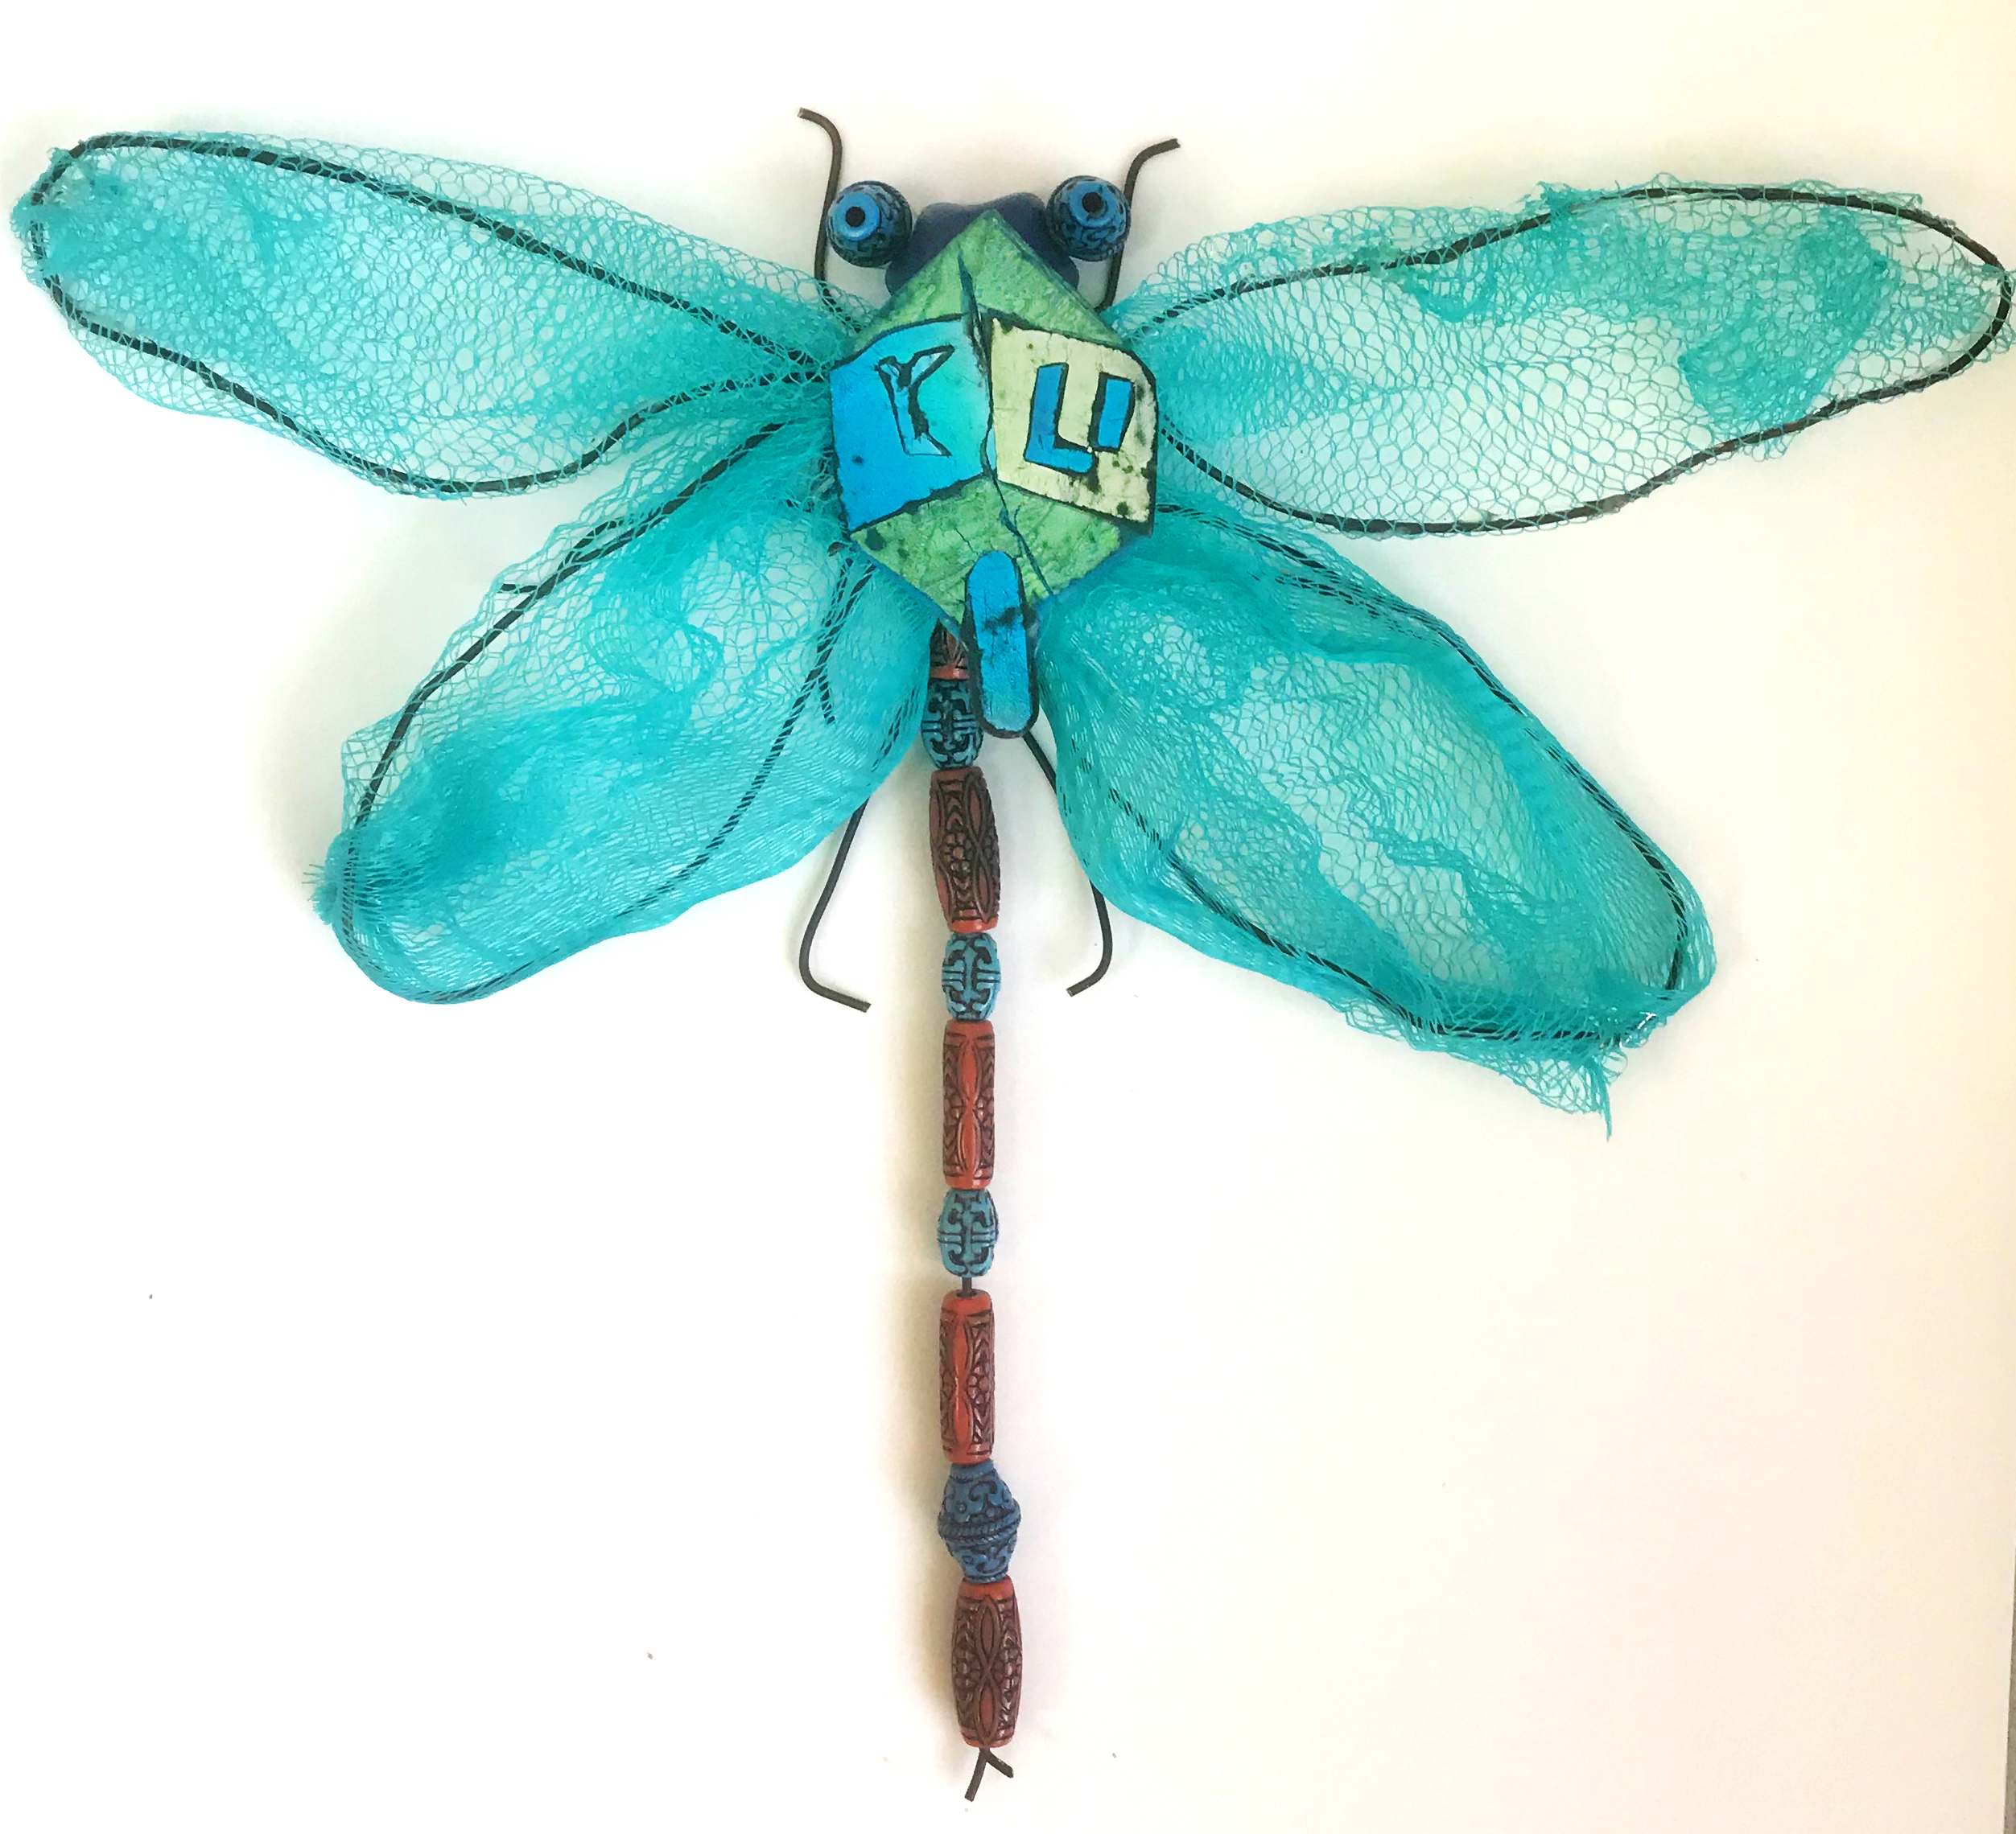
Blogs: Reflections Gestures of Support
“This is a new opportunity for all of us to really challenge our own perspectives of what is possible. Go about it with as much enthusiasm as possible, despite the circumstances, mindset is everything!”
“It is going to be a readjustment …but think about it like this, generations to come will most likely have some sort of education in this format. Therefore we are setting the sails for the future of education and schooling forever! “

Slide 7
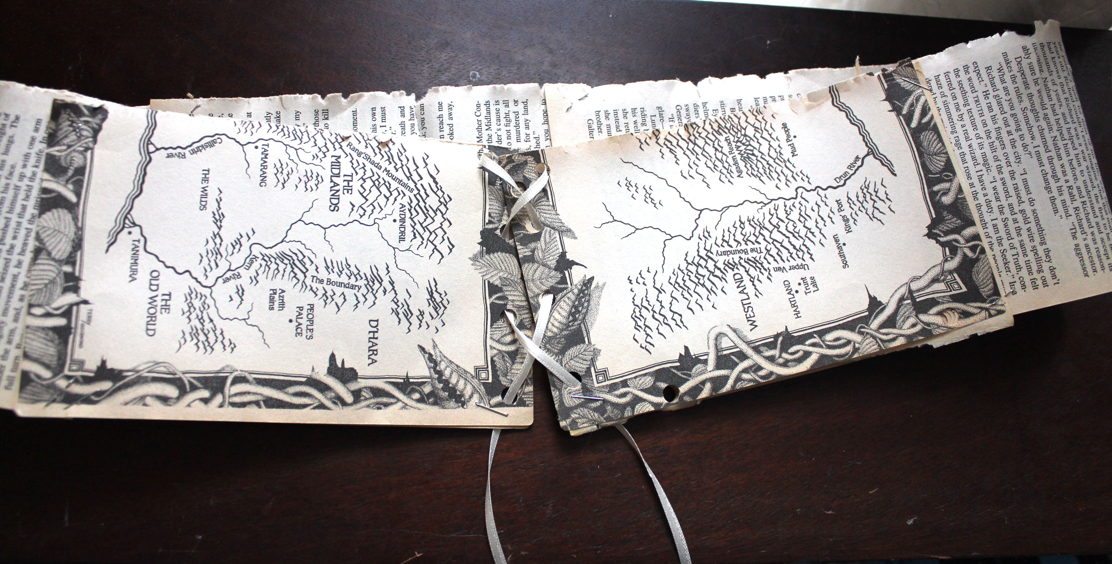
Blogs: Structured, Step by Step Learning Sharing Process, not just Product “We are in this together” community feeling

Slide 8
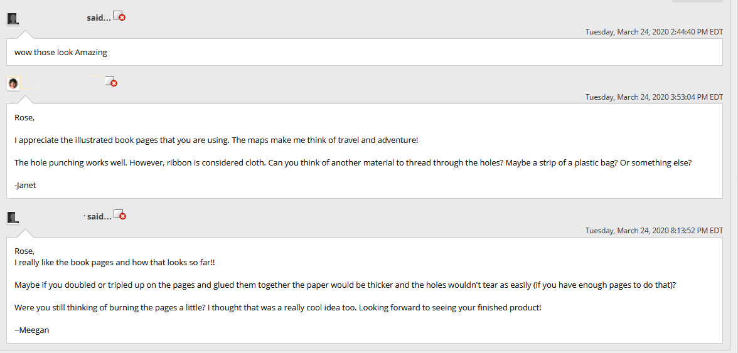
Blogs: Daily progress photos, notes about challenges, questions Responses offering continuous support, group problem solving

Slide 9
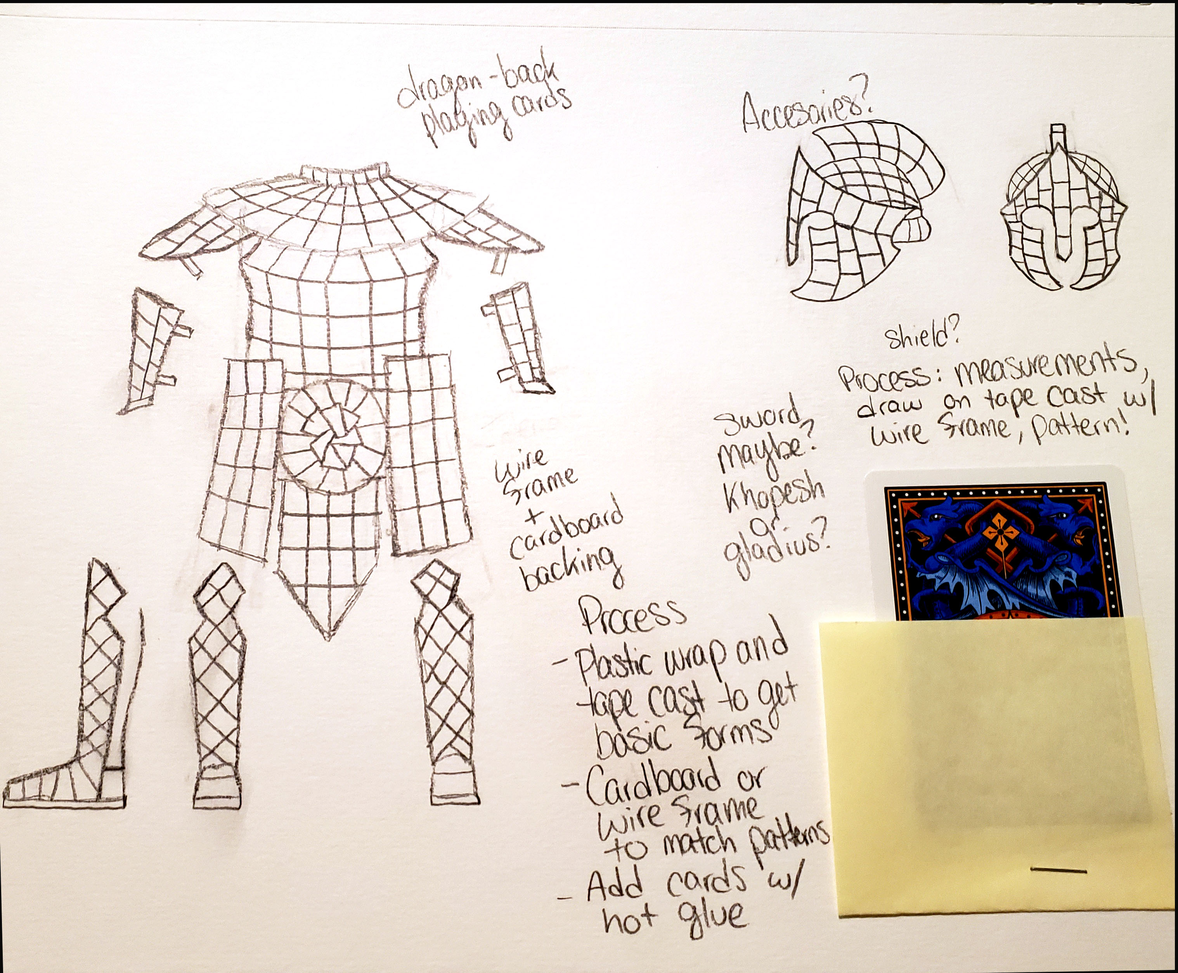
Blogs: Structured, Step by Step Learning Sharing Process, not just Product

Slide 10
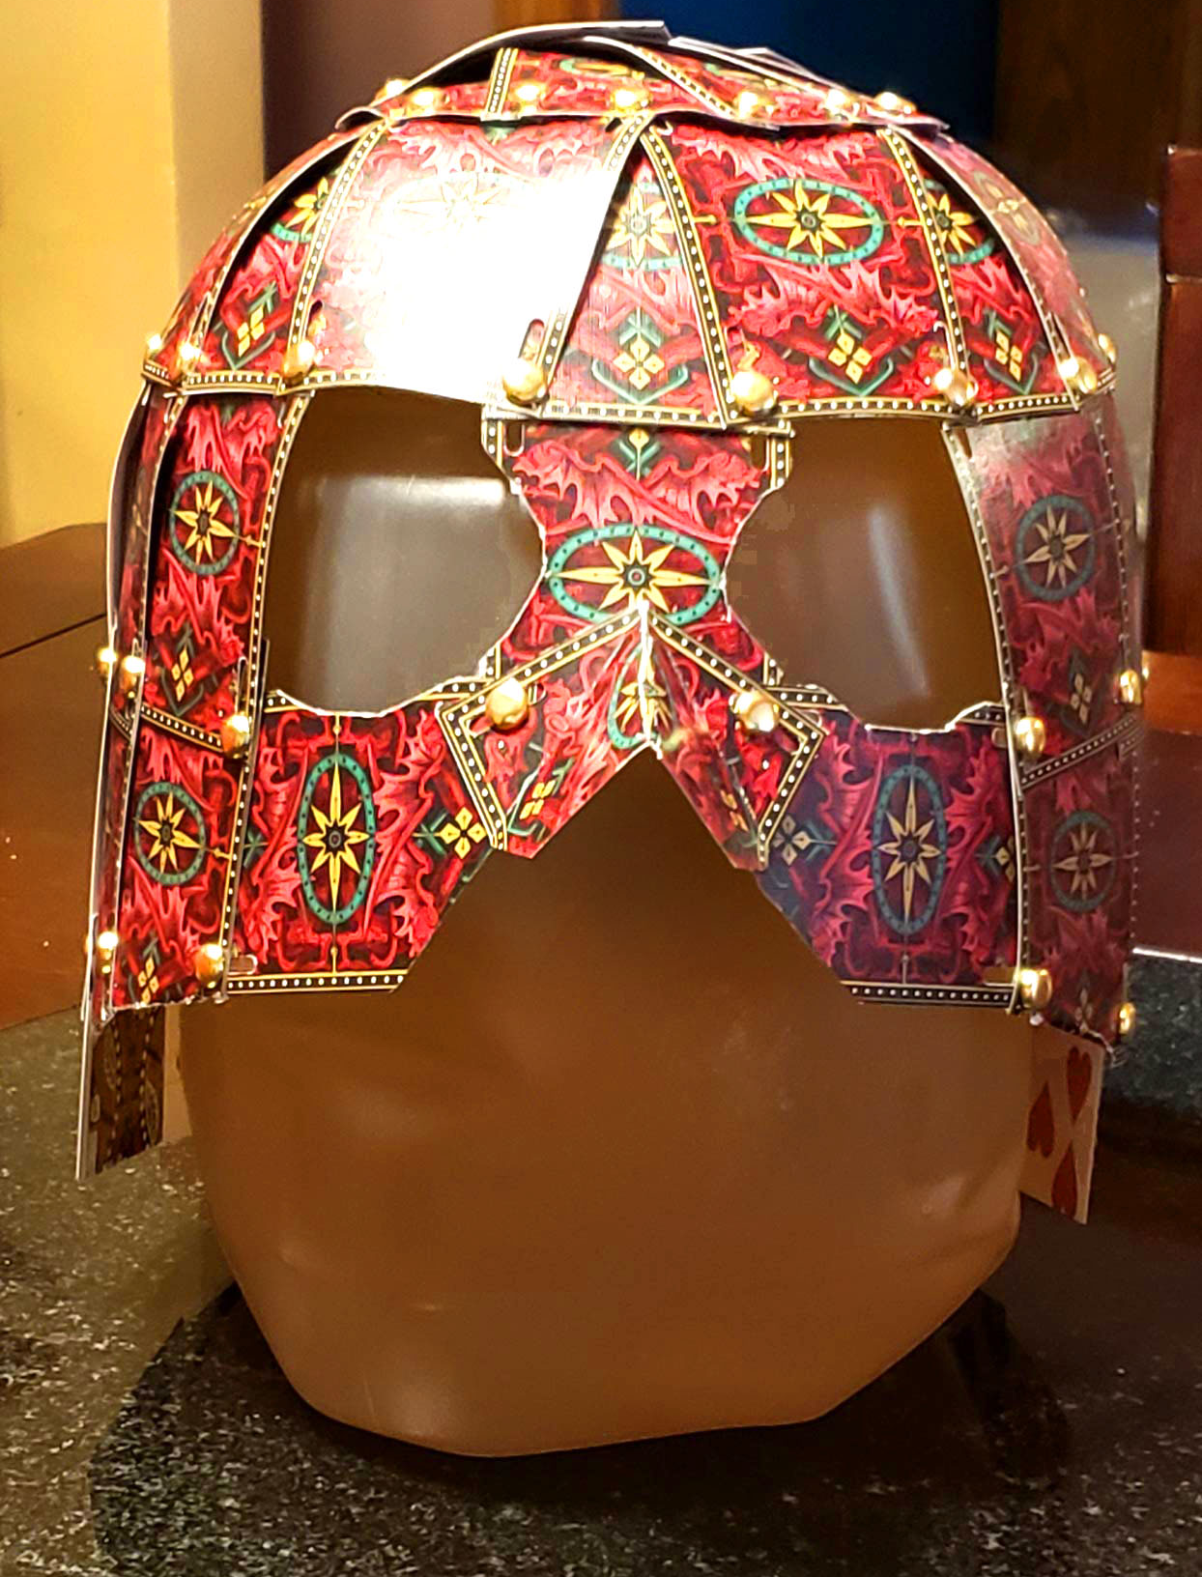
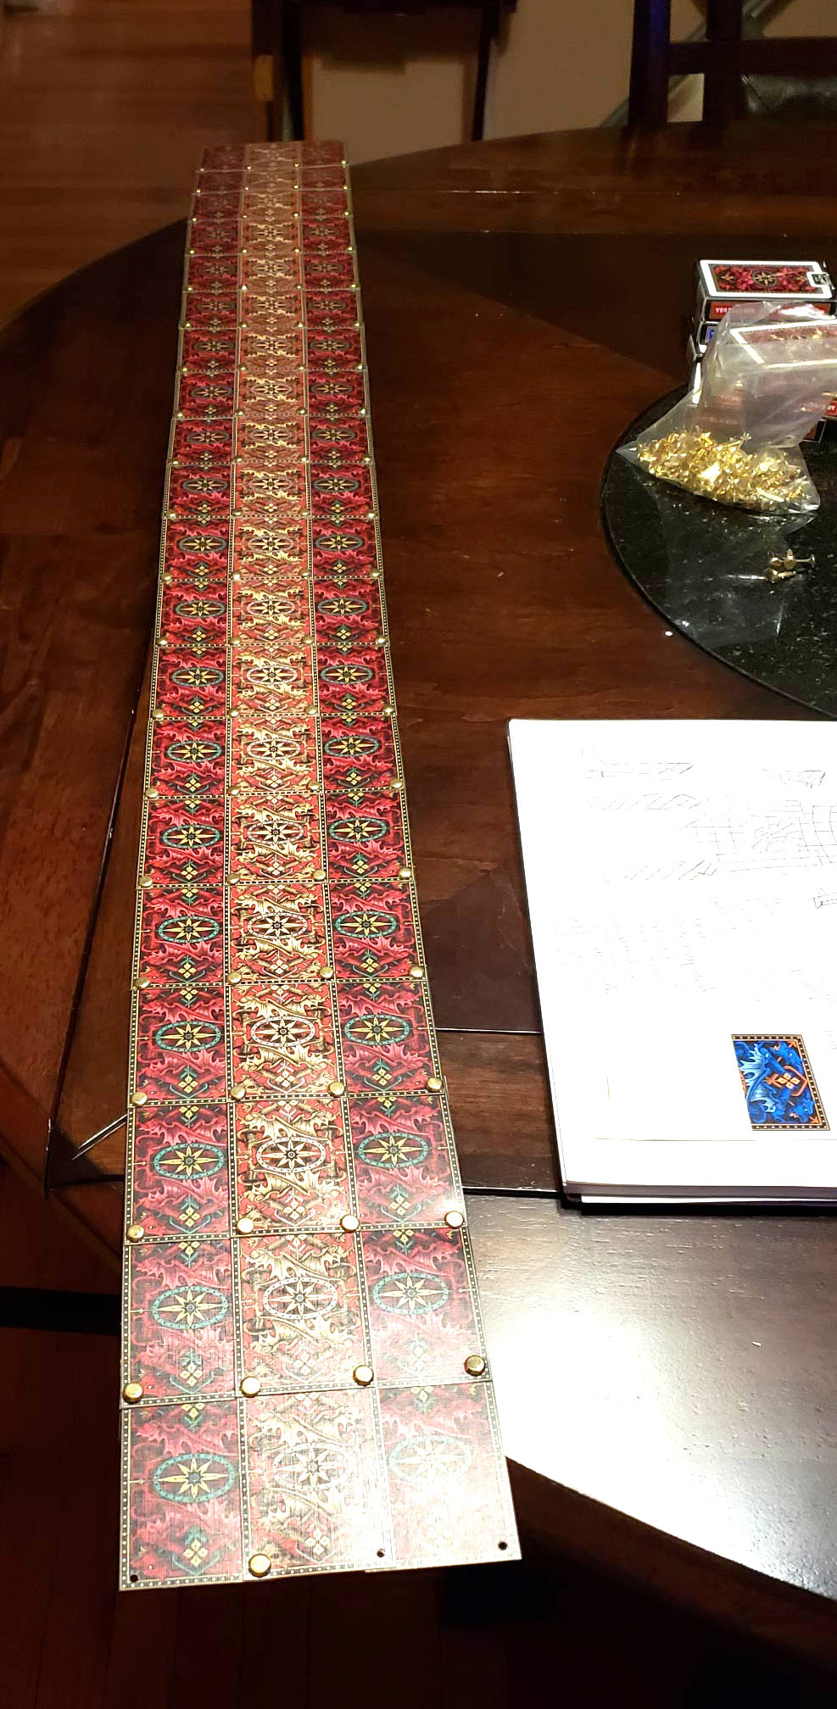
Why Blogs? Structured, Step by Step Learning Sharing Process, not just Product

Slide 11
Blogs vs. Discussions Brauer, James. “Blogging vs Threaded Discussions in Online Courses.” Connected Principals, 7 Oct. 2012, connectedprincipals.com/archives/6431.Web Secondary source summary of : Clarke, L, & Kinne, L. (2012). Asynchronous discussions as threaded discussions or blogs. Journal of Digital Learning in Teacher Education, 29, 4-13
According to their research, students who blogged about coursework and posted responses to classmates, developed a strong sense of community amongst each other.
“Because the form of blog writing tends to be less “academic” and more personal, students linked their meaning of academic material to their own lives and experiences. This resulted in more candid and personal discourse amongst the class.”
While students maintained attention to the various academic topics of study, they did so with their own voice.

Slide 12
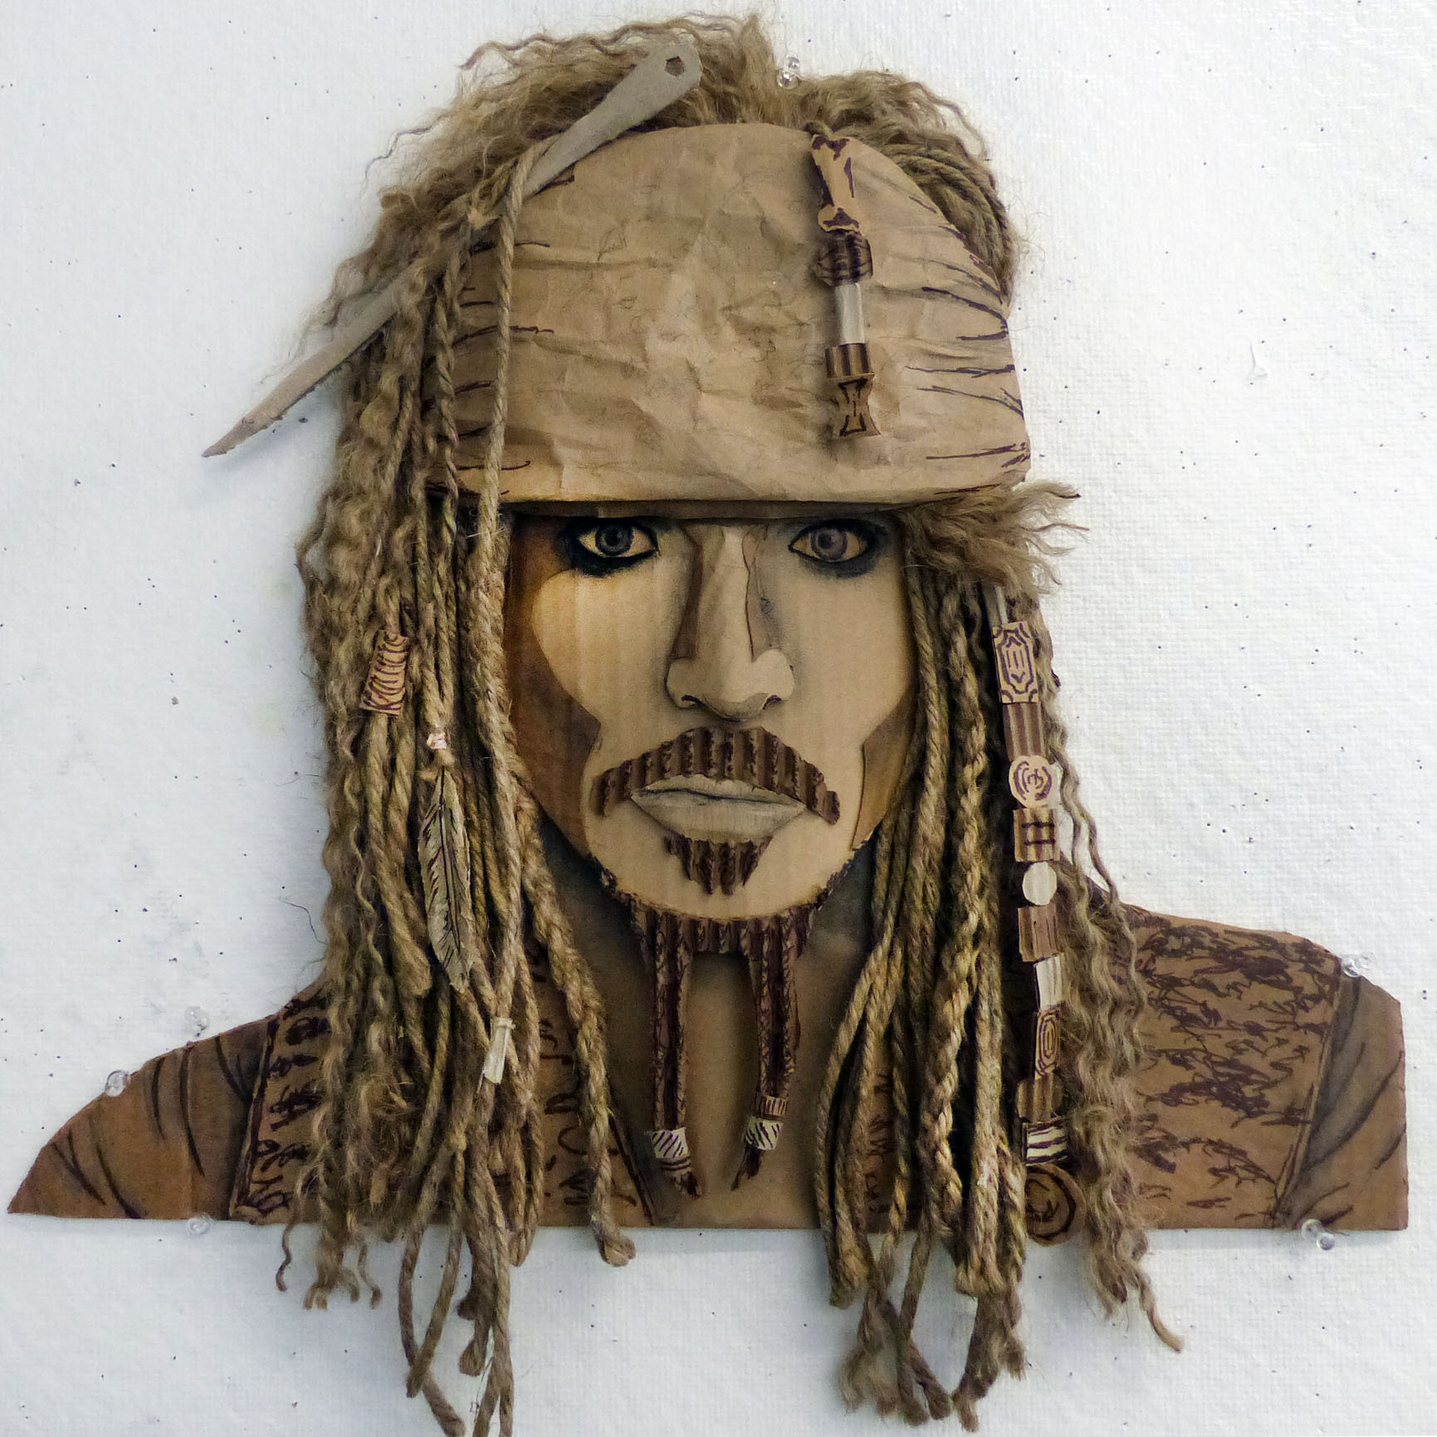
Blogs Growing Connections Reflections
Chiara Ferragni
The I would like my portrait to represent her beauty and strength as a woman in a culture that is still mostly male dominant. Seeing her post pictures and videos of quarantine has helped me enjoy my time at home and inspires me to try and enjoy the simpler things, like spending more time with my family and trying to get some exercise in everyday.

Slide 13
Blogs: Student Feedback
I think the most helpful part of our newly online class is the use of blogs. Seeing fellow students' work and processes as recorded on their blogs is inspirational and I feel like it helps everyone learn and find new solutions while we work on our projects.
It is also extremely helpful to be able to leave feedback on each other's posts, and to receive feedback from the professor, all of which can be returned to whenever you need a reminder of what was said or suggested.
In that way, it's actually more helpful than face-to-face discussions, assuming you don't have a perfect memory.

Slide 14
Blogs: Student Feedback
Blogs are helpful because you see the progress of other people’s projects and have their feedback
I have been able to get really involved in my projects even though we are not together.
I feel like I get to see and hear about other peoples ideas, even though we are not together.

Slide 15
Other Aspects of the Courses: Student Feedback
The most positive aspects of the class so far are:
examples of artwork (not only those of professionals but also examples of student artists previously assigned similar projects. )
related reference websites to independent study
unlimited opportunities for instructor feedback in a very timely manner
Ongoing opportunities to interact with classmates
Clearly stated timeline schedules presented for assignments with reminders

Slide 16
Final Product posted in Discussion Post A more formal forum for summaries and analyses
If you were designing this dress, how would you have painted it?
What story does it remind you of?
“This piece expresses the flow of reading and how the story paints a picture in your mind. I like to use reading as a way to escape into a fantasy world with magic and the supernatural.
I feel it is important to step back from the chaos of our world and read about others…

Slide 17
Final Product posted in Discussion Post A more formal forum for summaries and analysis “We are in this together” community feeling
I believe that this war commentary can also be extended to the fact that this armor is made out of playing cards, representing the idea that anyone who goes off to battle is gambling with their own life for the sake of something greater than themselves.
If you had built the armor how would you have built it differently?
What content or meaning would you assign to this piece, if any?

